Slide 1
The Battle between Python and R
Does the Snake Win?

Slide 2
Agenda
Introduction
Context
Considerations
Winner
Github
Questions

Slide 3
Introduction
Data is everywhere these days, and all are working to turn the data into actionable information. In this presentation we will discuss the pros and cons (or advantage and disadvantages) of two of the more popular programing tools that have extensive data analysis and machine learning capabilities: Python and R.

Slide 4


Descriptions by Wikipedia
“Python is an interpreted, high-level, general-purpose programming language. Created by Guido van Rossum and first released in 1991, Python's design philosophy emphasizes code readability with its notable use of significant whitespace. Its language constructs and object-oriented approach aim to help programmers write clear, logical code for small and large-scale projects.”
https://en.wikipedia.org/wiki/Python_(programming_language)
“R is a programming language and free software environment for statistical computing and graphics supported by the R Foundation for Statistical Computing. The R language is widely used among statisticians and data miners for developing statistical software and data analysis. Polls, data mining surveys, and studies of scholarly literature databases show substantial increases in popularity; as of January 2020, R ranks 18th in the TIOBE index, a measure of popularity of programming languages.”
https://en.wikipedia.org/wiki/R_(programming_language)

Slide 5
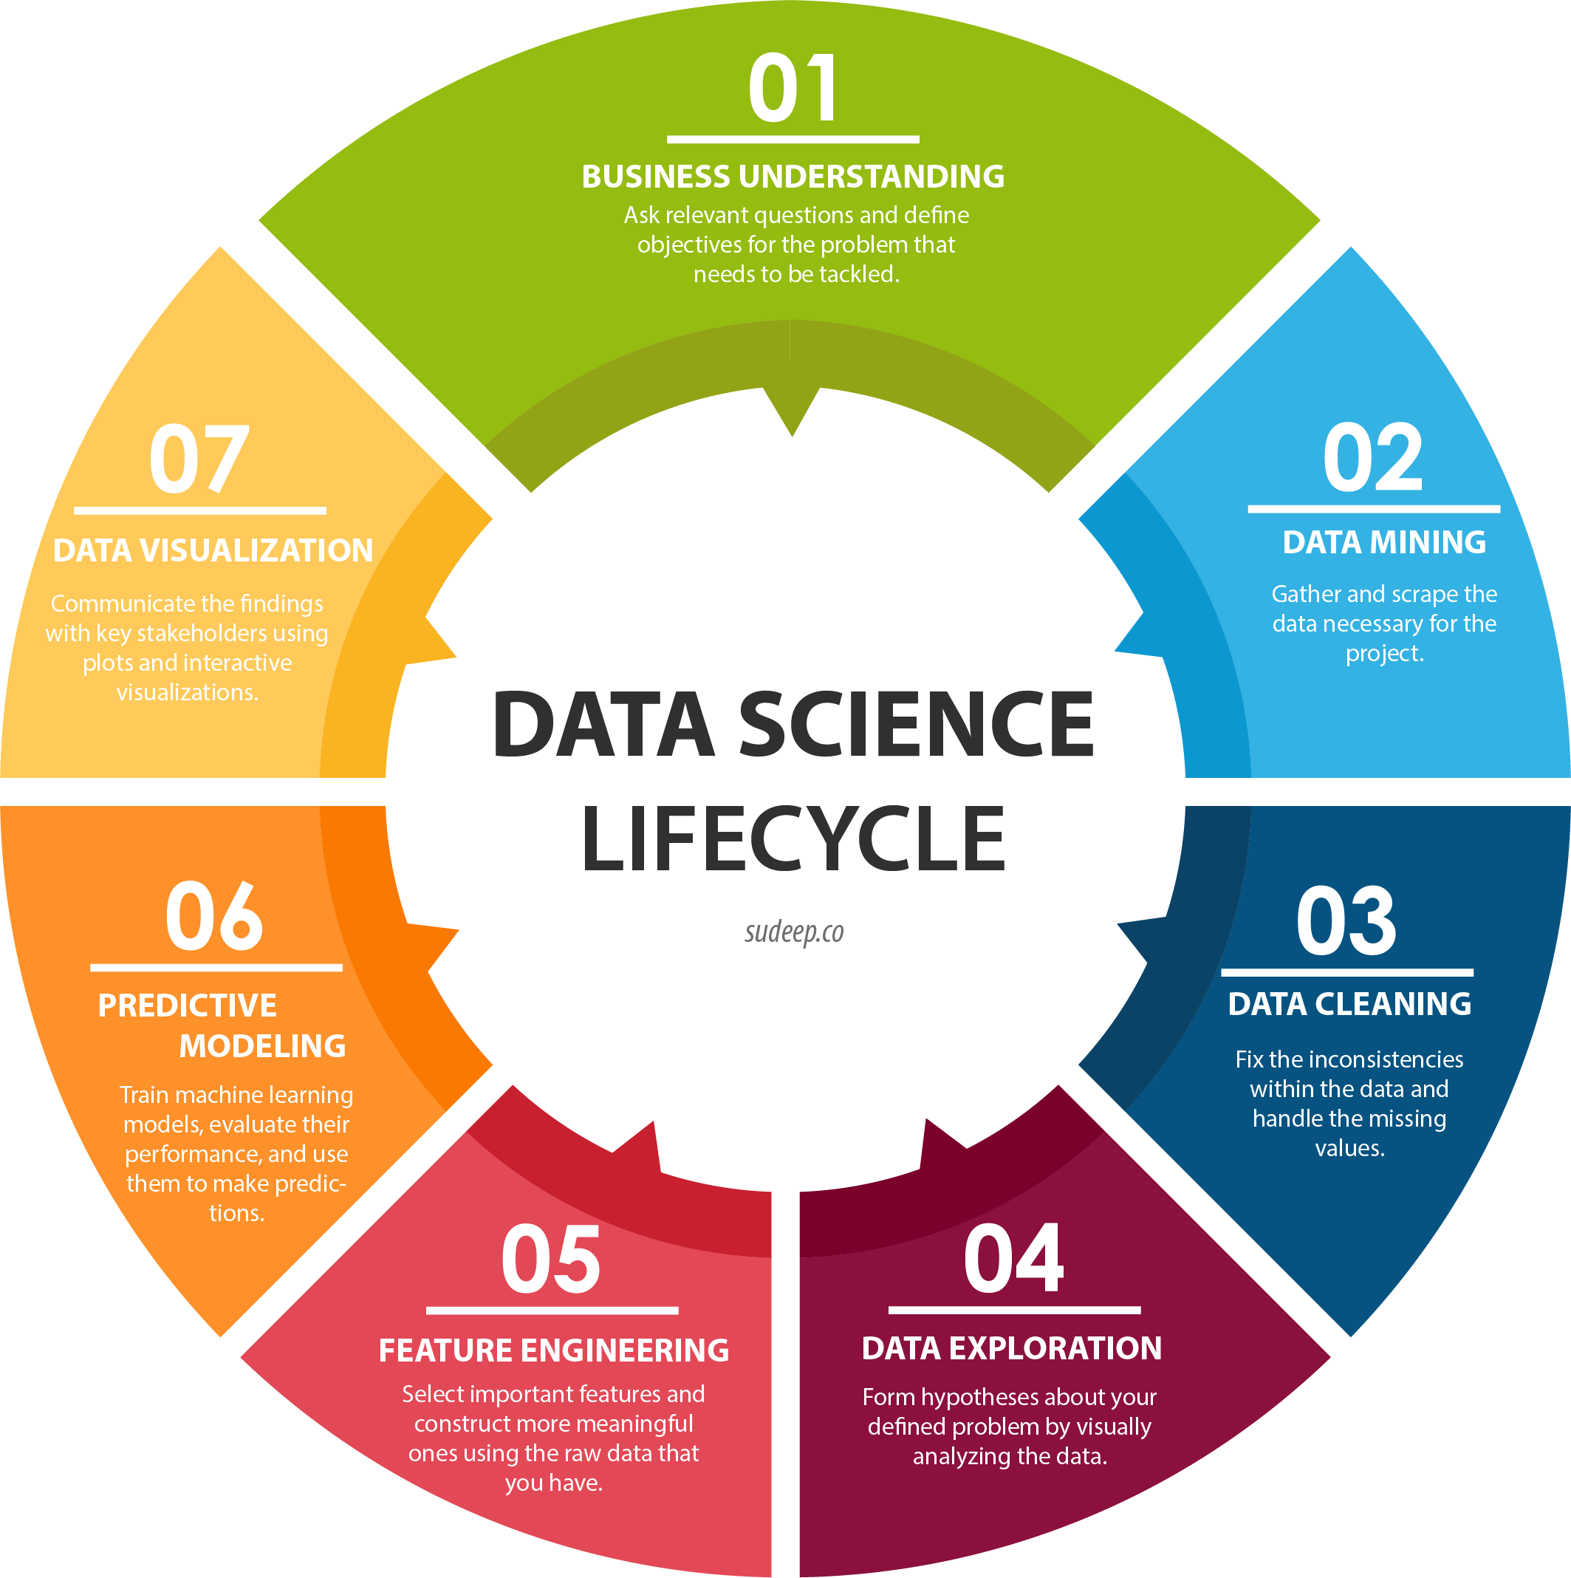
Context – Data Science
For purposes of this discussion, we will focus on the use of these tools in the data science arena.

Slide 6
How Machines Learn
Memory
Data Storage
Meaning (Abstraction)
Training – Data transformed to a concept
Generalization
Form used for future similar situations
Evaluation
Review performance

Slide 7
Questions
What languages do your colleagues use?
What are you solving?
What is your cost?
What is common in the field?

Slide 8
Considerations
Advantages
Disadvantages
Usability
Ecosystem
Data handling Capabilities
IDE (Integrated Development Environment)
Popular Libraries/Packages
Support/Community

Slide 9


Advantages
General purpose programming languages
Known for code readability, speed, and functionalities
Ease of deploy and reproducibility
Learn how algorithms (and mathematics) work
More popular for ML
Beautiful graphs and visualizations
Data analysis functionality
Statistical analysis

Slide 10
Disadvantages
Smaller number of libraries
No replacement for many R packages
Errors show up in runtime, significant debugging required
Visualizations a little behind R
Developed by statisticians, not for coding efficiency
It can be time consuming to find right package
Many dependencies between R libraries.
Slow if written poorly

Slide 11
Usability
Full fledge language and can be used in production
Integrates with web app
Syntax helps with coding and debugging
Code is affected by indentation
Functionality is written same way
Statistical model can be built with few lines of code
Functionality can be programmed in multiple ways
Standalone computing or analysis

Slide 12
Ecosystem
Clear and elegant, easily interpretable, and easy to type
Build data science pipelines and machine learning products integrated with web frameworks at scale
Python Package Index (PyPi) and Anaconda are repositories of Python software with all libraries
A rich ecosystem of packages to communicate between open-source languages.
Building workflows for data analysis
Packages available
Comprehensive R Archive Network (CRAN):
Bioconductor: Open source software for bioinformatics
GitHub: Web-based Git repository hosting service

Slide 13
Data Handling Capabilities
Requires users to install packages
NumPy and pandas
Handles basic data analysis without additional libraries
Large number of packages, readily usable tests, and the advantage of using formulas.

Slide 14
IDE
Jupyter Notebooks
Jupyter Labs
Spyder
Rodeo, the “data science IDE for Python.”
Rstudio
RStudio Desktop
RStudio Server

Slide 15
Popular Packages/Libraries
pandas to easily manipulate data
statsmodels to explore data, estimate statistical models, and perform statistical tests and unit tests
SciPy and NumPy for scientific computing
Scikit-learn for machine learning
Matplotlib and seaborn to make graphics
dplyr, Hdyr and data.table to easily manipulate data
stringr to manipulate strings
zoo to work with regular and irregular time series
ggplot2 to visualize data
caret for machine learning

Slide 16
Support/Communities
Stack Overflow
Reddit Python
PyLadies.com
Pydata.org
Stack Overflow
Reddit rstats
Rdocumentation.org
ropensci.org

Slide 17
Winner
Summary
Decision

Slide 18
Summary
Measure | Python | R
Objective | Deployment and production | Data analysis and statistics
Primary Users | Programmers and Developers | Scholar and R&D
Learning Curve | Linear curve | Difficult at beginning
Integration | Well-integrated app | Run locally
Task | Can be deployed | Easy to get initial results
IDE | Notebook, Ipython, Spyder | Rstudio

Slide 19
Decision
For deployable solutions
For statistical research

Slide 20
Github

Slide 21
Github
https://github.com/chrisholt0222/PythonvsR
Analysis of Home Pricing data using Python and R
R: “Analysis – Rmarkup.rnd”
Python: “Analysis – Jupyter Notebook.ipynb”

Slide 22
Questions

Slide 23
Thank You
Christopher M. Holt, ACAS, MAAA
christopher.m.holt@att.net
678-799-2294

